Slide 1
Object Oriented Programming in Python
Clay Elmore
February 1, 2019

Slide 2
Procedure Oriented Programming
“Traditional Programming”
Code manipulates existing data
Data and actions are inherently separate
“Routines” (functions) determine the program
C, Fortran are perfect examples

Slide 3
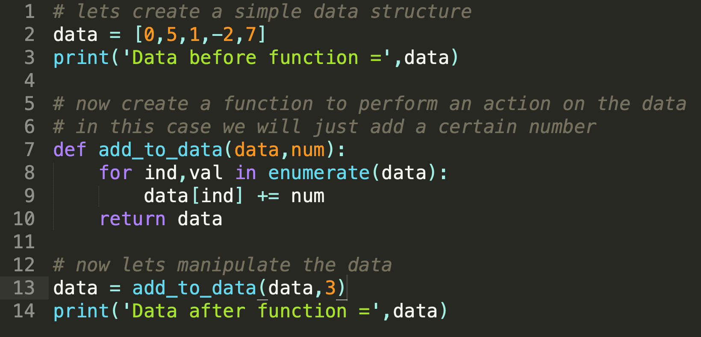
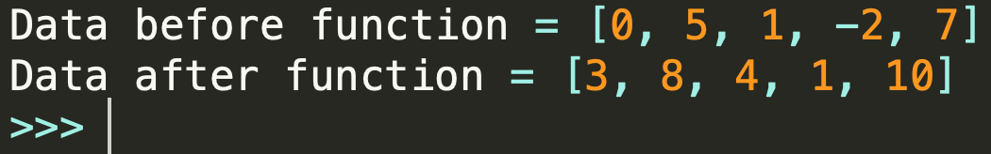
POP Example

Slide 4
Object Oriented Programming
Data and actions inherently coupled
Main Concepts:
  Data Specification (Encapsulation)
  Object Relationships (Inheritance)
  Action Flexibility (Polymorphism)
Python, Java, C++, C Sharp are great OOP examples
Source: https://www.quora.com/What-are-the-three-principles-of-object-oriented-programming

Slide 5
Comparison

Slide 6
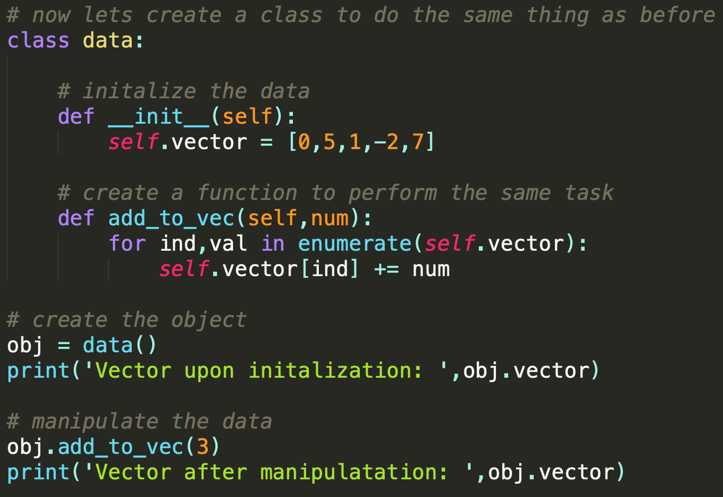
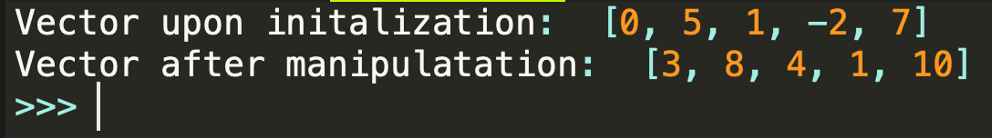
Simple Python OOP Example

Slide 7
Reasons to use OOP
Code is EXTREMELY reusable
Large scale development is much easier
Code is generally more robust in OOP vs POP
Parallelizing tasks is easy
GitHub community loves you

Slide 8
Downfalls of OOP
Harder to write extremely fast OOP for mathematics
  C and Fortran run the HPC world
  This is starting to change with things like TensorFlow
Non-optimized OOP can use a lot of memory
  Always try to use “commercial” grade objects (NumPy, Pandas)

Slide 9
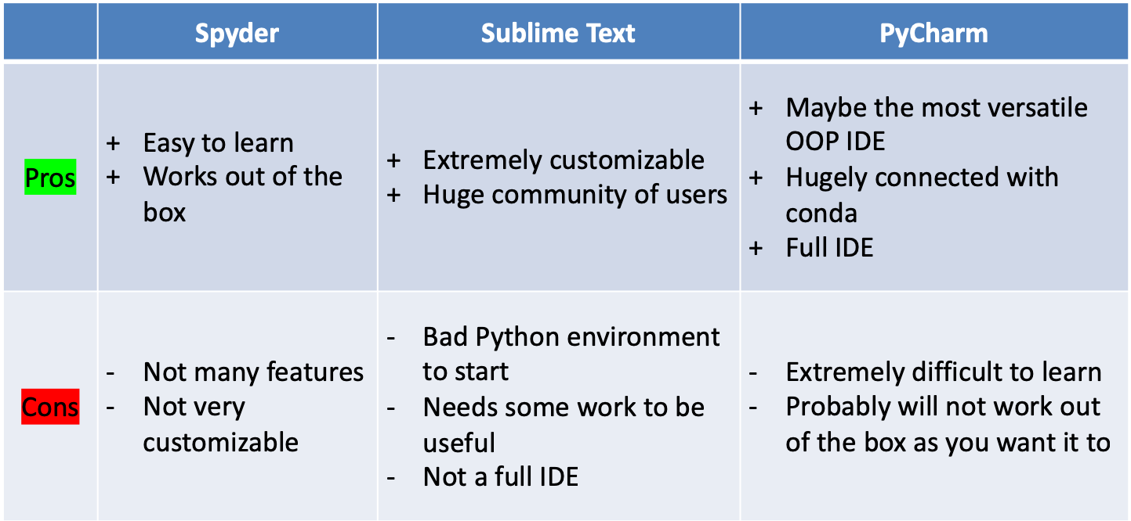
Recommendations of IDE’s for OOP

Slide 10
Questions Before Moving to Jupyter
?

